Slide 1

Joe Manke & Adam Meaney

Slide 2
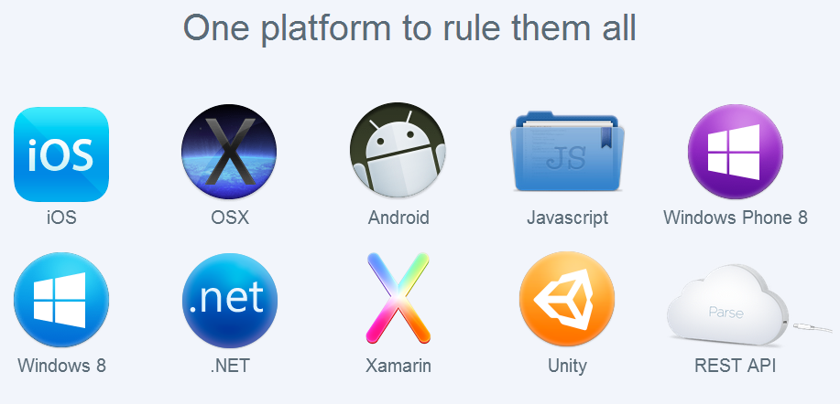
What is Parse?
A cloud backend for mobile and desktop apps
Provides servers, push notifications, social network integration, web hosting, analytics, and cloud computing
Multi-platform

Slide 3

Parse Data
Store app data in the cloud
Can push app updates through the cloud
Data browser for backend data management
View and update from spreadsheet
Filtering data

Slide 4

Parse Push
Simplified creation of push notifications
Send cross-platform notifications
Targeting
Scheduling

Slide 5

Parse Social
Use traditional logins or connect via third-party social networks (Facebook, Twitter, etc.)
Links accounts across networks
Allows sign-in on multiple devices/platforms

Slide 6

Parse Hosting
Host web apps using HTML, JavaScript, and CSS
Free subdomain at parseapp.com

Slide 7

Parse Analytics
Measure app usage
Monitor push campaigns (how often users open app from push notification)
Custom analytics

Slide 8

Cloud Code
Run custom app code in the cloud
Uses the Parse JavaScript SDK
Manage through command terminal

Slide 9
GeoPoints
Associates latitude and longitude coordinates with an object
Put ParseGeoPoint object into a ParseObject
Can use to find things near user’s current location
Create ParseQuery<ParseObject>
whereNear(String key, ParseGeoPoint point)
whereWithinGeoBox(String key, ParseGeoPoint point1, ParseGeoPoint point2)
Possible to set behaviors based on proximity

Slide 10
Sources
parse.com

